Slide 1

What is
investment?
Notes:
[Sources]
- C:/Users/oehle/Documents/oehler-huang-platform/apps/library/investment-analysis/handouts/Investment Version 24.docx
- https://www.apec2026.cn/node_196.html
[/Sources]

Slide 2

Two people buy the same shares.
Can one be investing while the other is speculating?
Notes:
First judgement: students answer yes or no and give one reason before any definition is taught.
[Sources]
- C:/Users/oehle/Documents/igcse-term-outlines/outputs/investment-course-one-semester/Investment and Financial Decision-Making - 2026-27 Semester 1 Bilingual Department Leadership Learning Summary.pdf
- C:/Users/oehle/Documents/oehler-huang-platform/apps/library/investment-analysis/handouts/Investment Version 24.docx
- C:/Users/oehle/Documents/oehler-huang-platform/apps/library/assets/js/investment-photos.js
[/Sources]

Slide 3
By the end of this lesson
1. Define financial investment, speculation and saving
定义金融投资、投机与储蓄
2. Distinguish decisions by purpose, expected payoff basis, liquidity, evidence and possible loss
根据目的、预期回报依据、流动性、证据与潜在损失进行区分
3. Explain what investment is, what it is not, and justify a classification
说明什么是投资、什么不是投资，并论证分类
Notes:
[Sources]
- C:/Users/oehle/Documents/igcse-term-outlines/outputs/investment-course-one-semester/Investment and Financial Decision-Making - 2026-27 Semester 1 Bilingual Department Leadership Learning Summary.pdf
[/Sources]

Slide 4
Classify the decision, not the asset
1. Main purpose
2. Expected payoff basis (预期回报依据)
3. Liquidity (流动性)
4. Evidence (证据)
5. Possible loss (潜在损失)
These factors explain what investment is—and what it is not.
Notes:
[Sources]
- C:/Users/oehle/Documents/igcse-term-outlines/outputs/investment-course-one-semester/Investment and Financial Decision-Making - 2026-27 Semester 1 Bilingual Department Leadership Learning Summary.pdf
[/Sources]

Slide 5
Is this investment?
Notes:
[Sources]
- https://uk.finance.yahoo.com/news/investing-money-savings-risks-finances-050038406.html
[/Sources]

Slide 6

Is this investment?
Notes:
[Sources]
- https://www.cnbc.com/2019/12/18/how-to-build-an-emergency-savings-fund.html
[/Sources]

Slide 7
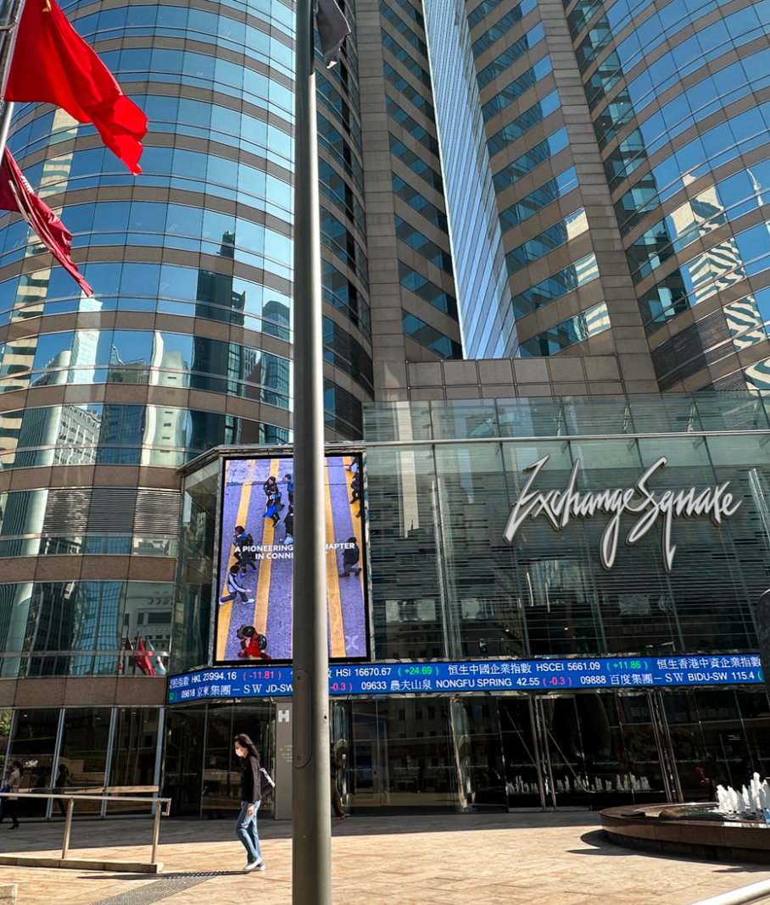
Definition of investment
Financial investment (金融投资) means putting money into an asset (资产) to seek future total return (总回报).
Total return = income + change in market value
Risk: possible loss (可能亏损)
Examples: stocks, index funds, bonds and property
Notes:
[Sources]
- C:/Users/oehle/Documents/oehler-huang-platform/apps/library/investment-analysis/handouts/Investment Version 24.docx
- https://www.chinadailyhk.com/hk/article/605229
[/Sources]

Slide 8
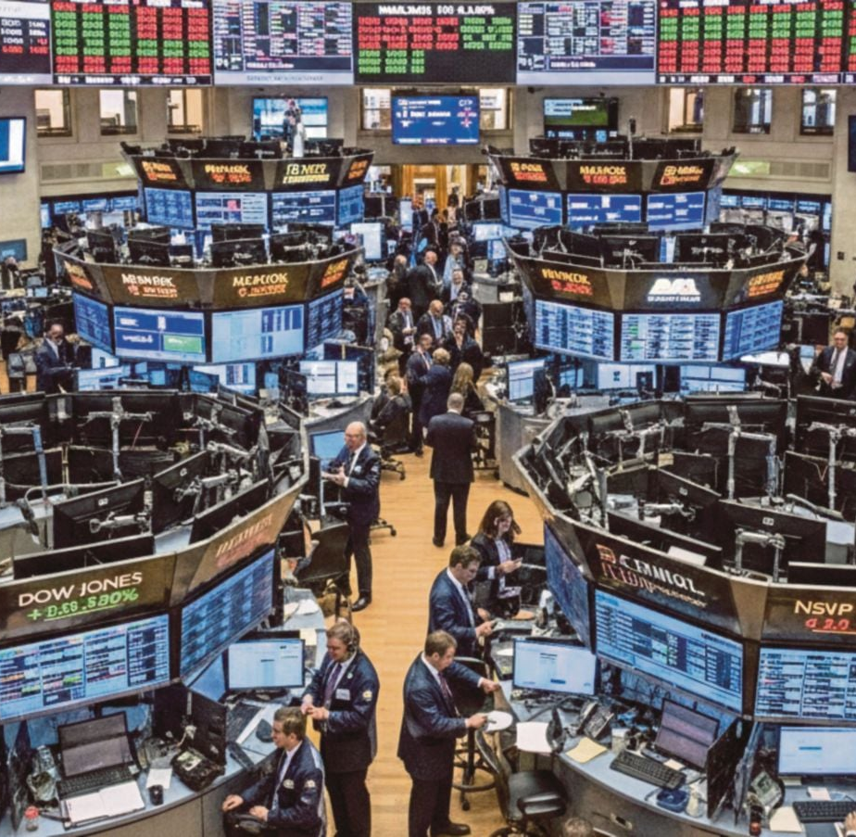
Real example of total return
S&P 500, calendar 2025
Price return: 16.39%
Total return with dividends: 17.88%
USD 10,000 would become:
USD 11,639 without dividends
USD 11,788 with dividends
The difference came from dividends.
Notes:
Data as of 31 December 2025. The USD illustration excludes fees, taxes and currency effects.
[Sources]
- https://www.spglobal.com/spdji/en/commentary/article/us-equities-market-attributes/
- https://www.nst.com.my/business/corporate/2026/02/1371314/stocks-fluctuate-after-wall-street-ai-fuelled-sell
[/Sources]

Slide 9
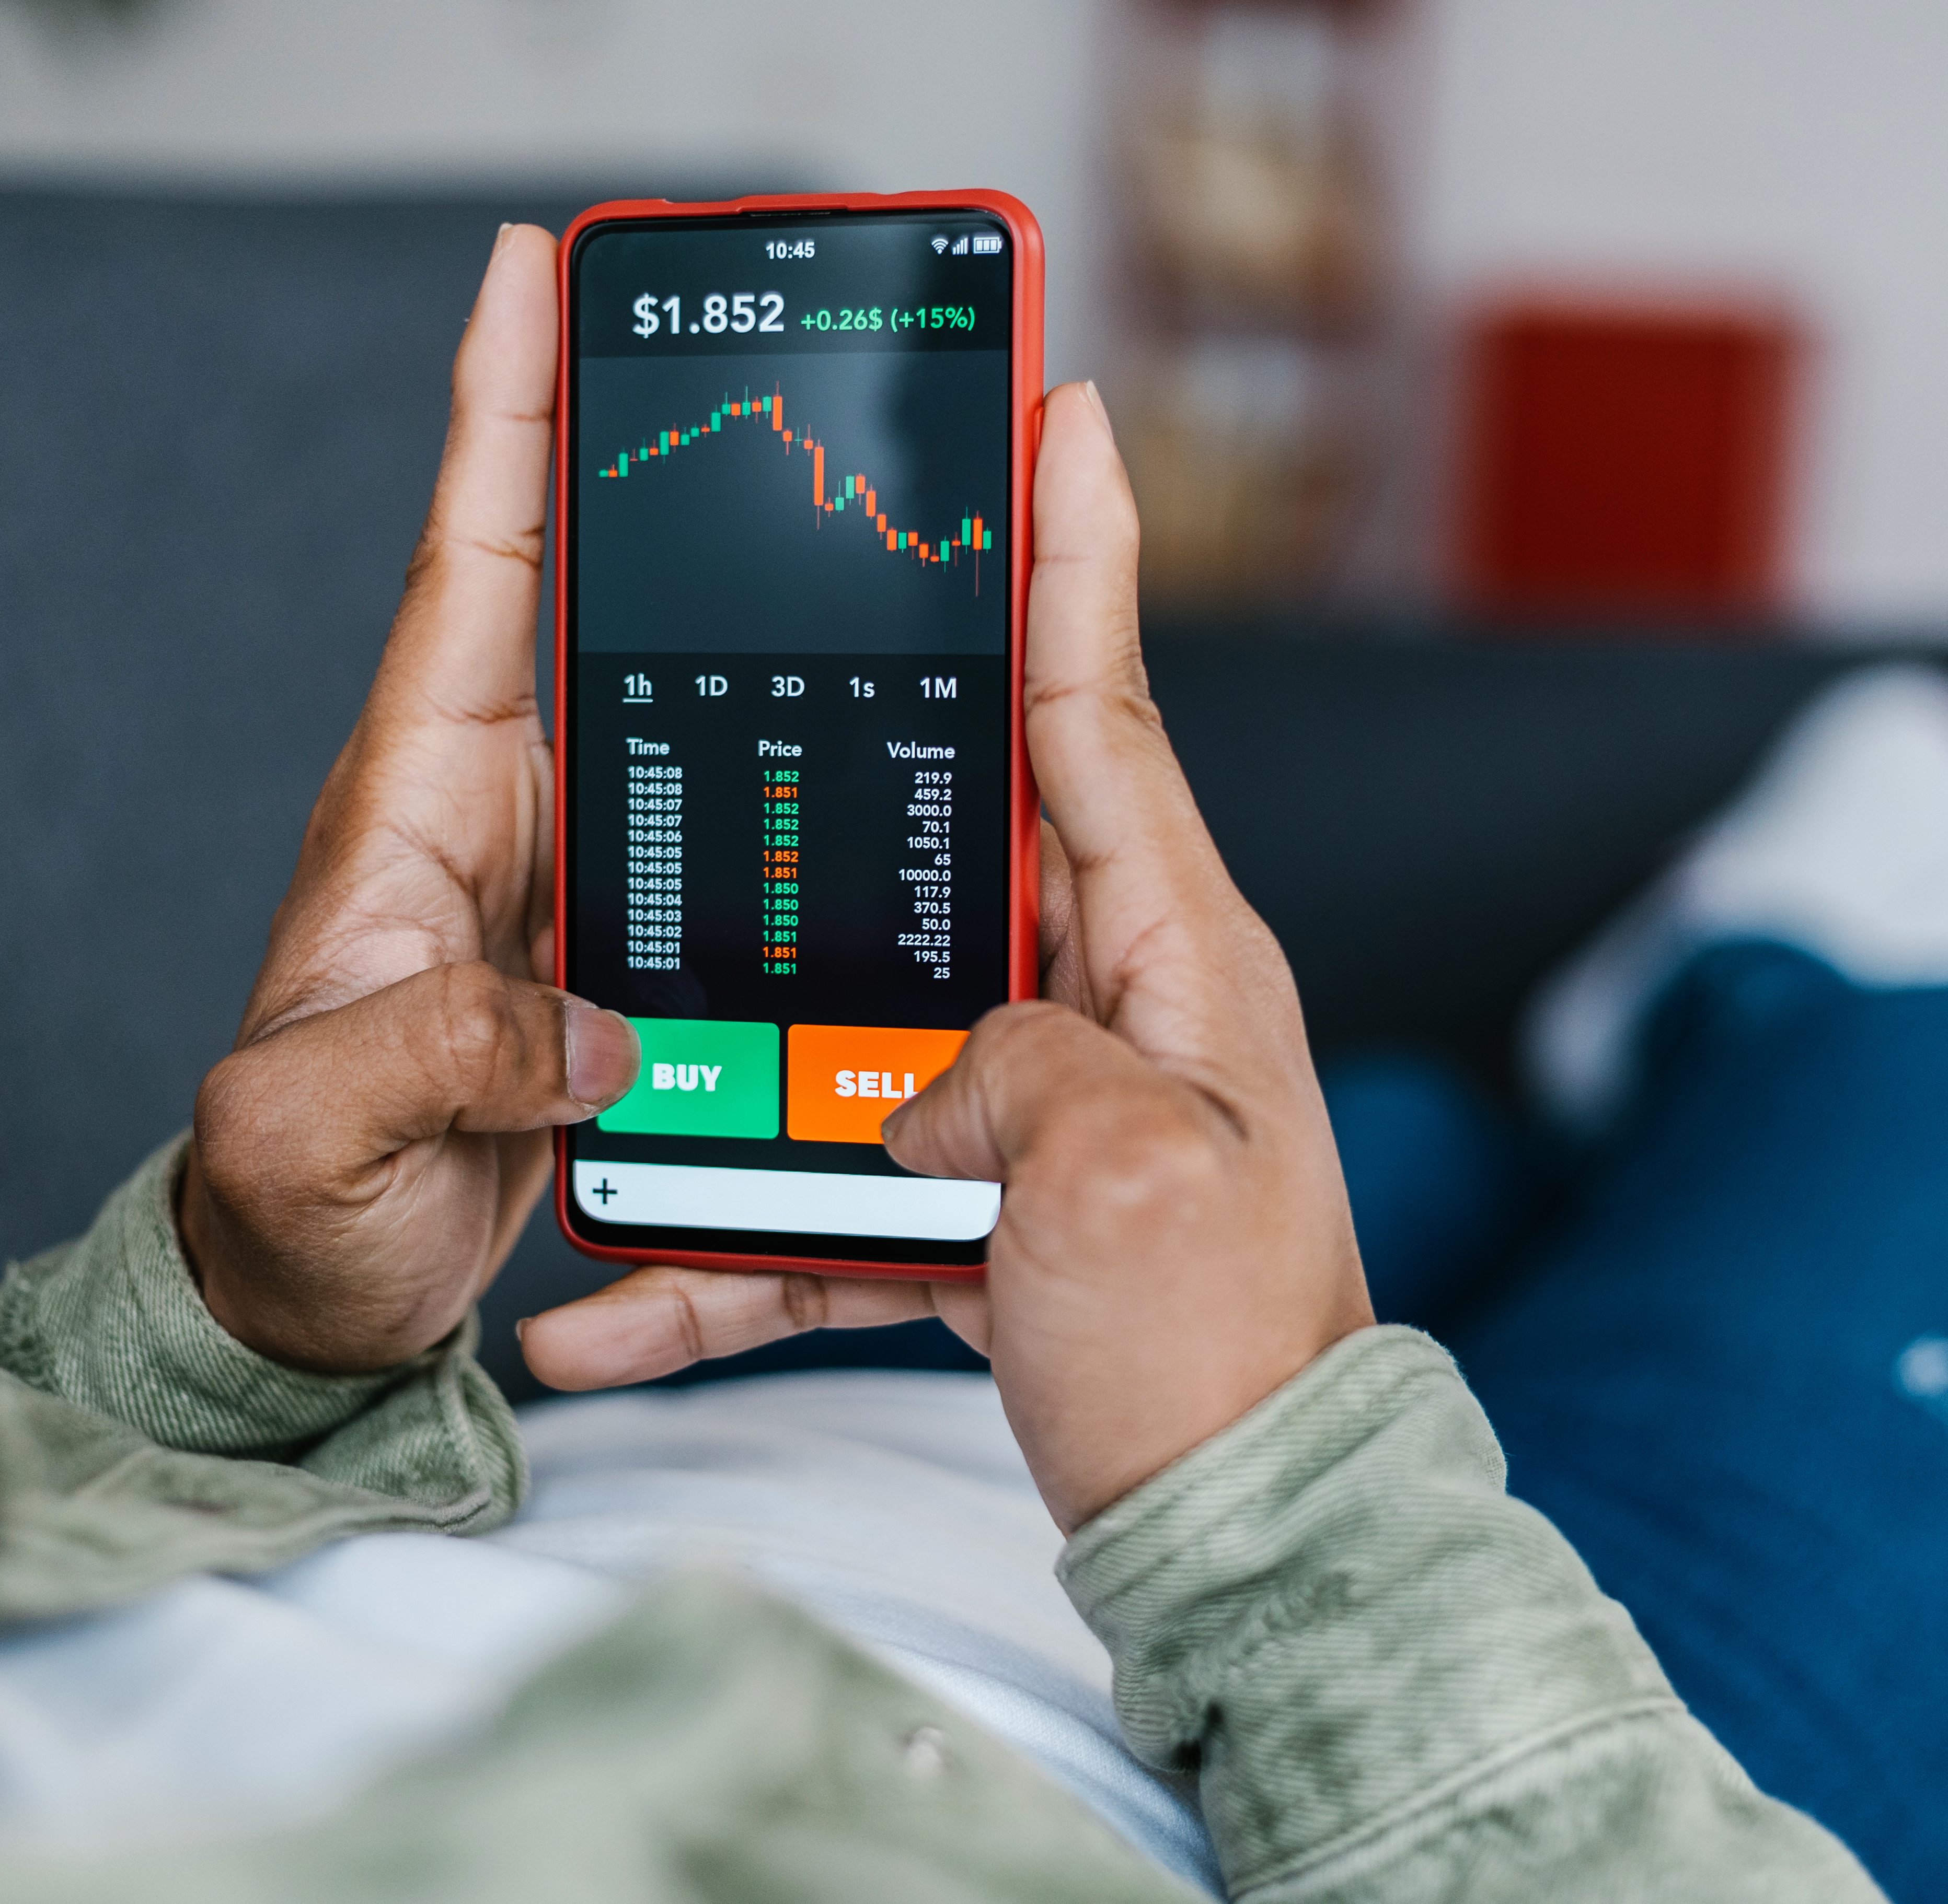
Definition of speculation
Speculation (投机) means trading mainly to profit from a predicted price change (预测的价格变动).
Income or underlying value (基础价值) is not the main basis.
Examples: shares bought after a rumour, gold bought for rapid resale, or currency traded after an exchange-rate prediction.
Notes:
[Sources]
- C:/Users/oehle/Documents/oehler-huang-platform/apps/library/investment-analysis/handouts/Investment Version 24.docx
- https://www.kiplinger.com/investing/ways-your-phone-can-help-you-weather-market-volatility
[/Sources]

Slide 10
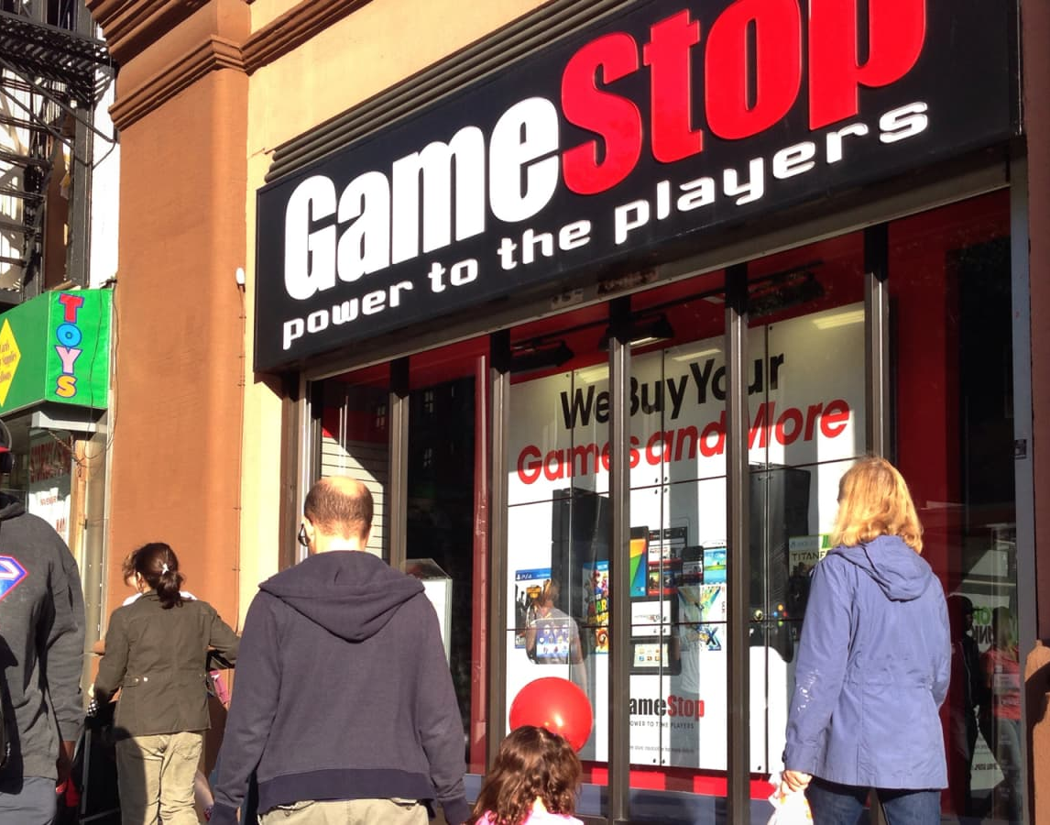
Real example of speculation
GameStop, January 2021
• More than 1,600% rise from the 11 January close to the 27 January close
• USD 483 intraday high on 28 January
• More than 86% fall from that high by the end of the first week of February
Notes:
Figures are pre-2022 stock-split prices, as reported by the SEC.
[Sources]
- https://www.sec.gov/files/staff-report-equity-options-market-struction-conditions-early-2021.pdf
- https://www.cnbc.com/2019/03/27/gamestop-doubling-down-on-its-investment-in-surging-esports-industry.html
[/Sources]

Slide 11
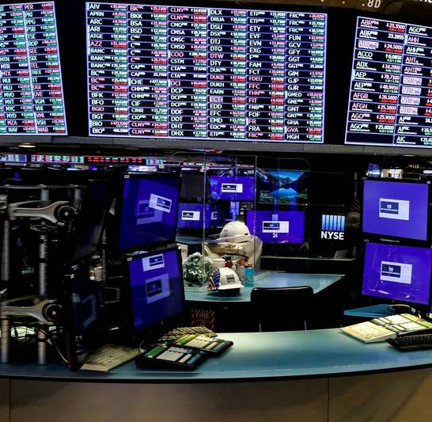
Why economists usually don’t favour speculation
One reason is the cost of frequent trading.
A study of 66,465 households found annual returns of:
Most-active households: 11.4%
Market: 17.9%
Trading costs reduced the net return of the most-active group.
Notes:
Barber and Odean sample period: 1991-1996. Historical evidence does not predict every trader's result.
[Sources]
- https://faculty.haas.berkeley.edu/odean/papers/returns/individual_investor_performance_final.pdf
- https://ec.ltn.com.tw/article/breakingnews/3466782
[/Sources]

Slide 12

Definition of saving
Saving is current income not spent now.
Emphasis:
• capital preservation (保本)
• liquidity (流动性)
Examples:
• emergency fund (应急资金)
• examination fees held for a known date
• short-term cash buffer (现金缓冲)
Notes:
[Sources]
- C:/Users/oehle/Documents/oehler-huang-platform/apps/library/investment-analysis/handouts/Investment Version 24.docx
- https://www.lepoint.fr/eureka/pourquoi-les-tirelires-ont-elles-la-forme-d-un-cochon-27-09-2024-2571328_4706.php
[/Sources]

Slide 13
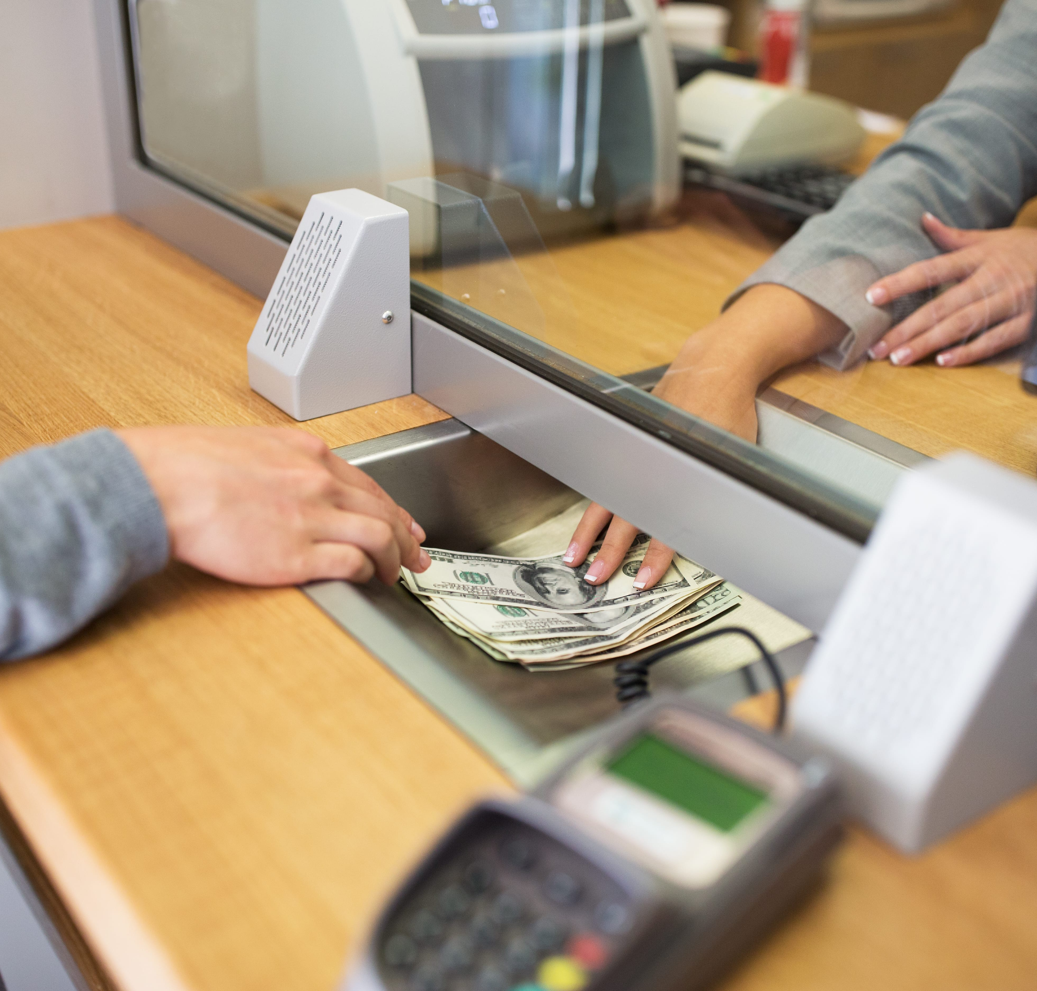
Example of saving
China, end-2025
CNY 167.0 trillion
domestic household deposits
9.7% increase from end-2024
Saving can serve a near-term need even when it earns some interest.
Notes:
[Sources]
- https://www.stats.gov.cn/english/PressRelease/202602/t20260228_1962661.html
- https://www.cca.org.mx/CCA_cursos/finanzas_personales/html/modulo3/modulo3-13.html
[/Sources]

Slide 14
Choose: Investment (投资), speculation (投机) or saving (储蓄)?
1. The main basis is expected income and/or evidence about underlying value; possible loss is accepted.
2. The main reason is a predicted price change; income or underlying value is not the main basis.
3. Money is kept mainly for a future need, safety and ready access.
4. Amina studies profits, cash flow and debt before buying a diversified share portfolio. She expects dividends and long-term price growth.
5. Bao borrows after an online rumour predicts a price rise next week. He will sell after an announcement.
Notes:
[Sources]
- C:/Users/oehle/Documents/oehler-huang-platform/apps/library/investment-analysis/handouts/Investment Version 24.docx
[/Sources]

Slide 15
Choose: Investment (投资), speculation (投机) or saving (储蓄)?
6. Chloe estimates rent, maintenance and vacancy costs. She buys a flat mainly for net rental income.
7. Daniel needs examination-fee money in eight months, so he uses an easy-access account for safety and liquidity.
8. Eva invests for university in ten years using a diversified fund. She reviewed fees and risks and accepts a possible fall in market value.
9. Farah keeps an emergency fund in an easy-access account. Quick withdrawal matters more than return.
10. George buys a bond fund for retirement after checking interest income, credit risk, interest-rate risk and fees.
Notes:
[Sources]
- C:/Users/oehle/Documents/oehler-huang-platform/apps/library/investment-analysis/handouts/Investment Version 24.docx
[/Sources]

Slide 16
Choose: Investment (投资), speculation (投机) or saving (储蓄)?
11. Hadi buys Bitcoin after an influencer predicts a weekend price jump. He will sell immediately if it happens.
12. Iris buys foreign currency before a central-bank announcement. Her expected gain depends on a price prediction.
13. Jun needs tuition money in three months, so he uses an easy-access account for safety and liquidity.
Notes:
[Sources]
- C:/Users/oehle/Documents/oehler-huang-platform/apps/library/investment-analysis/handouts/Investment Version 24.docx
[/Sources]

Slide 17
MCQ 1
What is the strongest evidence that a decision is a financial investment (金融投资)?
A. The asset has risen in price before.
B. The main basis is expected income and/or evidence about underlying value, while possible loss is accepted.
C. Money can be withdrawn immediately with no possible loss.
D. The buyer plans to sell after an unverified rumour.
Notes:
Answer: B
[Sources]
- C:/Users/oehle/Documents/oehler-huang-platform/apps/library/investment-analysis/handouts/Investment Version 24.docx
[/Sources]

Slide 18
MCQ 2
Which decision is saving (储蓄) rather than financial investment (金融投资)?
A. Keeping school-trip money in an easy-access account.
B. Buying a diversified fund for long-term growth after reviewing its fees and risks.
C. Buying shares for dividends and long-term value after analysing profits, debt and cash flow.
D. Buying property mainly for expected net rental income.
Notes:
Answer: A
[Sources]
- C:/Users/oehle/Documents/oehler-huang-platform/apps/library/investment-analysis/handouts/Investment Version 24.docx
[/Sources]

Slide 19
MCQ 3
Which evidence most clearly indicates speculation (投机)?
A. Expected bond interest after analysing credit risk.
B. Expected net rental income after estimating vacancy and maintenance.
C. Borrowing after a rumour of a next-week price jump and planning a quick sale.
D. Accepting that a diversified fund held long term can lose value.
Notes:
Answer: C
[Sources]
- C:/Users/oehle/Documents/oehler-huang-platform/apps/library/investment-analysis/handouts/Investment Version 24.docx
[/Sources]

Slide 20
MCQ 4
Which statement about saving (储蓄) is correct?
A. Earning interest automatically changes saving into financial investment (金融投资).
B. Saving cannot lose purchasing power (购买力).
C. Capital preservation (保本) and liquidity (流动性) can matter more than a high return.
D. Saving always means holding cash at home.
Notes:
Answer: C
[Sources]
- C:/Users/oehle/Documents/oehler-huang-platform/apps/library/investment-analysis/handouts/Investment Version 24.docx
[/Sources]

Slide 21
MCQ 5
Two people buy the same asset (资产). Why might one be investing (投资) and the other speculating (投机)?
A. The asset name decides the category.
B. The person who pays the higher price is the speculator (投机者).
C. One bases expected return on income and/or evidence about long-term value; the other mainly on a price prediction (价格预测).
D. The person planning to sell sooner is always the speculator (投机者).
Notes:
Answer: C
[Sources]
- C:/Users/oehle/Documents/oehler-huang-platform/apps/library/investment-analysis/handouts/Investment Version 24.docx
- C:/Users/oehle/Documents/igcse-term-outlines/outputs/investment-course-one-semester/Investment and Financial Decision-Making - 2026-27 Semester 1 Bilingual Department Leadership Learning Summary.pdf
[/Sources]

Slide 22

Short answer question 1
Mina receives ¥500 and has no money set aside for emergencies. Should she save some before investing? Explain.
Use at least two terms:
emergency fund (应急资金)
liquidity (流动性)
essential spending (必要支出)
possible loss (可能亏损)
Notes:
[Sources]
- C:/Users/oehle/Documents/oehler-huang-platform/apps/library/investment-analysis/handouts/Investment Version 24.docx
- https://www.hanseaticbank.de/klarmacher/vorsorgen/die-betriebliche-altersvorsorge-kuendigen-geht-das-ueberhaupt
[/Sources]

Slide 23

Short answer question 2
Leo needs the money for a laptop in six months. He wants a higher return but cannot afford a loss. Should he save or invest it? Explain.
Use at least two terms:
time horizon (投资期限)
liquidity (流动性)
capital preservation (保本)
possible loss (可能亏损)
Notes:
[Sources]
- C:/Users/oehle/Documents/oehler-huang-platform/apps/library/investment-analysis/handouts/Investment Version 24.docx
- https://www.coursehero.com/blog/product-team/
[/Sources]

Slide 24

Short answer question 3
Nora borrows money to buy shares after an unverified online rumour. She will sell tomorrow if the price rises.
What makes this speculation, and how can borrowing make the loss worse?
Use at least two terms:
rumour (传闻) • price prediction (价格预测)
repayment obligation (偿还义务) • possible loss (可能亏损)
Notes:
[Sources]
- C:/Users/oehle/Documents/oehler-huang-platform/apps/library/investment-analysis/handouts/Investment Version 24.docx
- https://www.tori.ng/news/73034/nigerian-stock-market-investors-gain-n175b.html
[/Sources]

